Slide 1
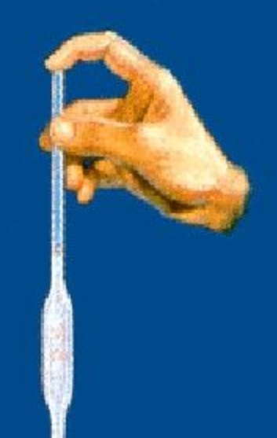
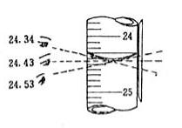

Error Analysis
Preparation of Standard Solutions
Liquid may drop outside the volumetric flask → lower concentration and absorbance
Solution remain in the pipet → lower concentration and absorbance
Read the scale from the upward view → smaller volume → greater concentration and absorbance
Colder than the working temperature (20°C) → smaller volume → higher concentration and absorbance.

Slide 2
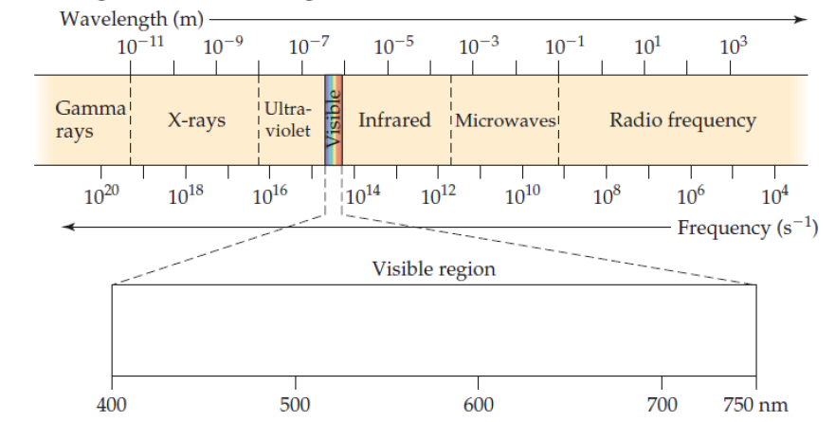
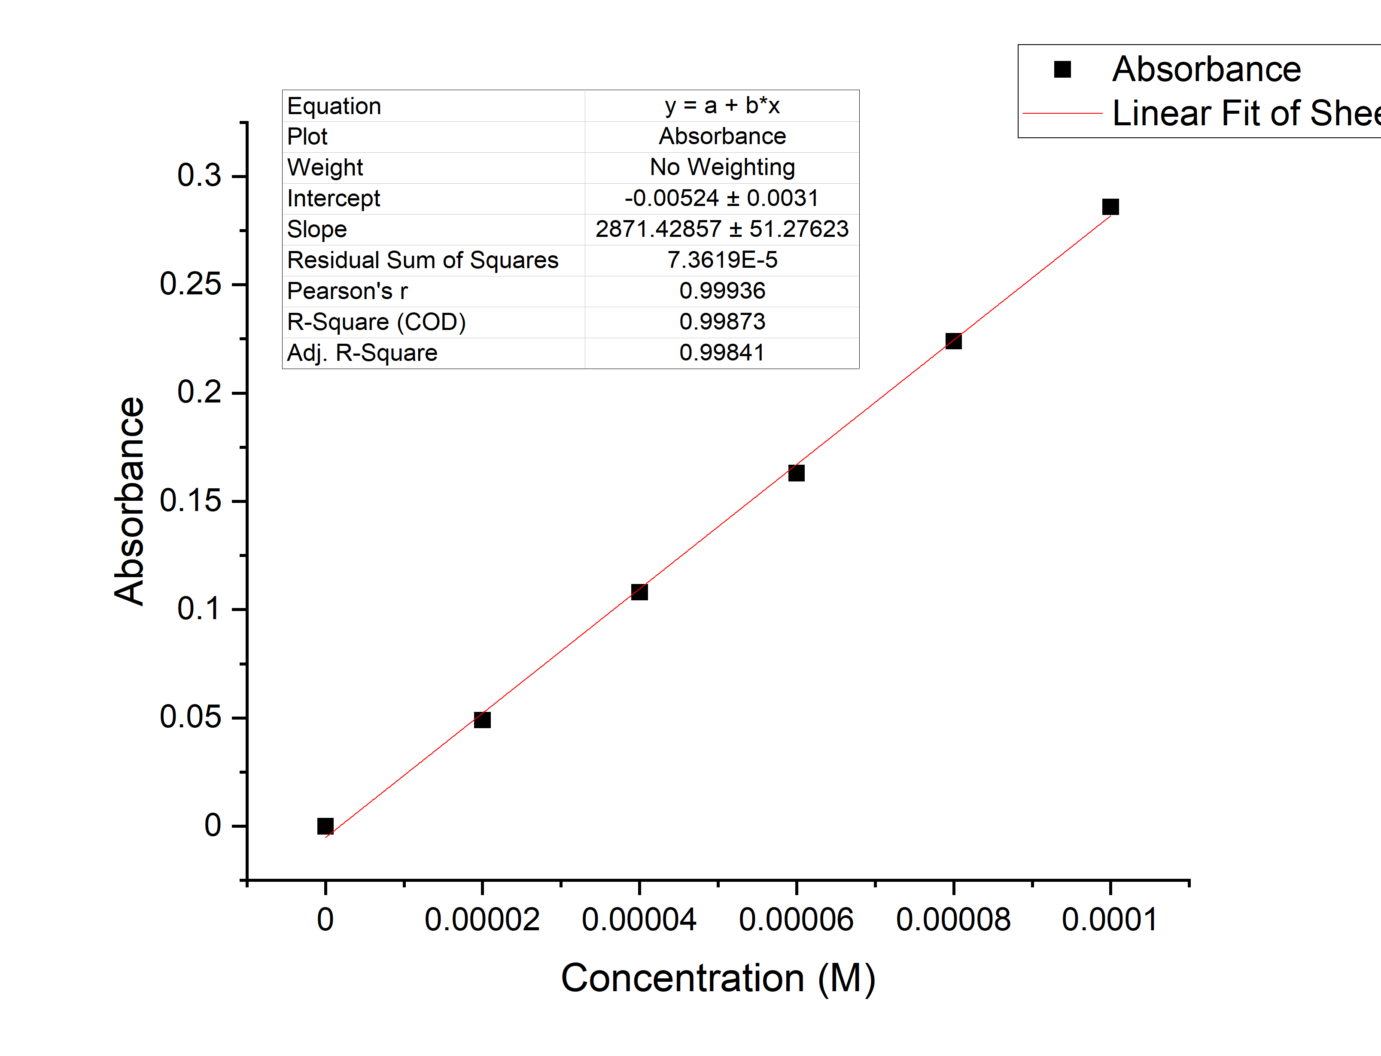

Error Analysis
B. Making the Absorbance Spectrum & Finding using a Standard Solution
Different knob position
Limit λ range
C. Making the Calibration Curve Using the standard Solutions
Bubbles exist
A positive intercept on x-axis → lower concentration

